Slide 1
Setup
Day 0
The Coding Bootcamp

Slide 2

Quick Introductions! (30 seconds)
Name
Location
Background (Career, Education, Interests)
Why learn web development?
Excited about class?
Notes:
This class is, after all, about you – so let’s do some introductions.
(You may also want to ask “Fears about class?” – that can turn a little negative, so be ready to dissuade/make happy the students if you do ask this)

Slide 3
Instructor = … ?
Your Name Here
<insert education or experience tidbit>
<insert education or experience tidbit>
Over <#> years coding, (with plenty of experience being a n00b at it.)
Insert image of you here
<personal fact>
Secretly, a <funny fact about yourself>
Insert image here
Notes:
Enough about you, time to talk about me.

Slide 4
Some Cool Stuff I Made…
SNAPSHOT OF SOMETHING
YOU MADE GOES HERE!
Notes:
Here’s this cool thing I built. It does X and it’s important because Y.
Questions?

Slide 5
Online Class Schedule
Notes:
Now that we’ve talked about the journey and how to be successful, let’s talk about the stops along the way.

Slide 6
Online Class
Weekdays
Office Hours: 5:45pm - 6:30pm
Class: 6:30pm - 9:30pm
Office Hours: 9:30pm - 10pm

Slide 7
Online Class
Saturday
Office Hours: 9:15am - 10:00am
Class: 10:00am - 2:00pm
Office Hours: 2:00pm – 2:30pm

Slide 8
Online Class
Office hours and class will be hosted on Zoom!
Notes:
More on Zoom and all of it’s awesome features in a bit.

Slide 9
Tools for Fools

Slide 10
Online Class
Bootcampspot
Slack
Zoom
Visual Studio Code
Notes:
Here is a quick overview of all of the technologies we’ll be setting up today.

Slide 11
Bootcampspot
Notes:
I want to spend a little bit of time checking that everyone has everything they need installed (from the pre-work).
If you can check off all of these things, spend this time helping others in slack. This should become a habit – try to ask for help form your peers before going to a TA (you will both learn more along the way). < We’ll talk more about this soon.
That said, let’s check some things off of a list.

Slide 12
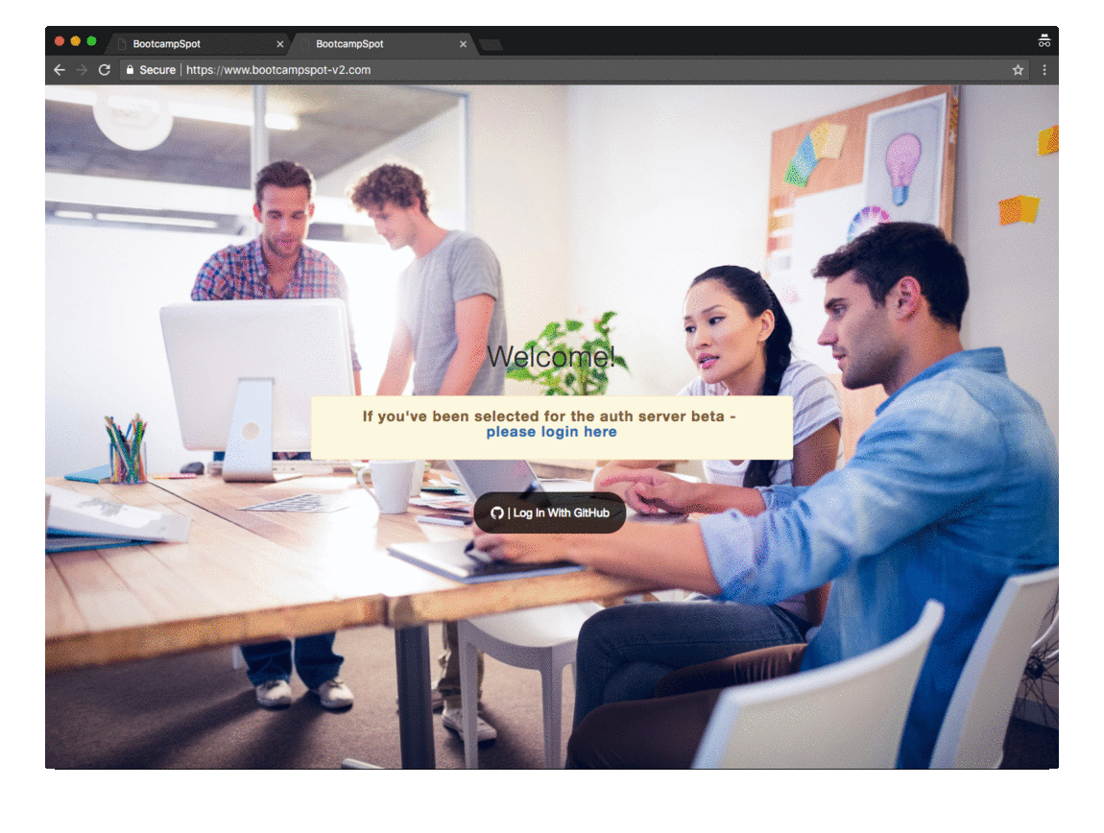
Logging In

Slide 13
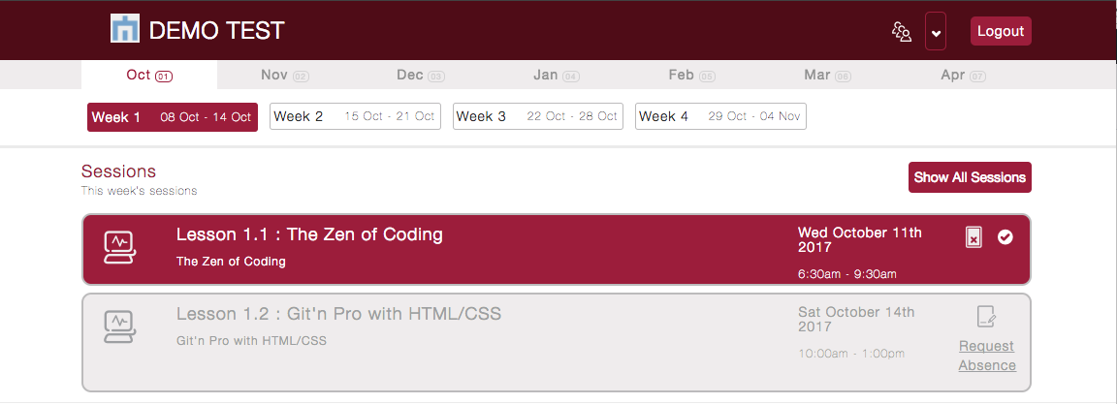
Marking Attendance

Slide 14
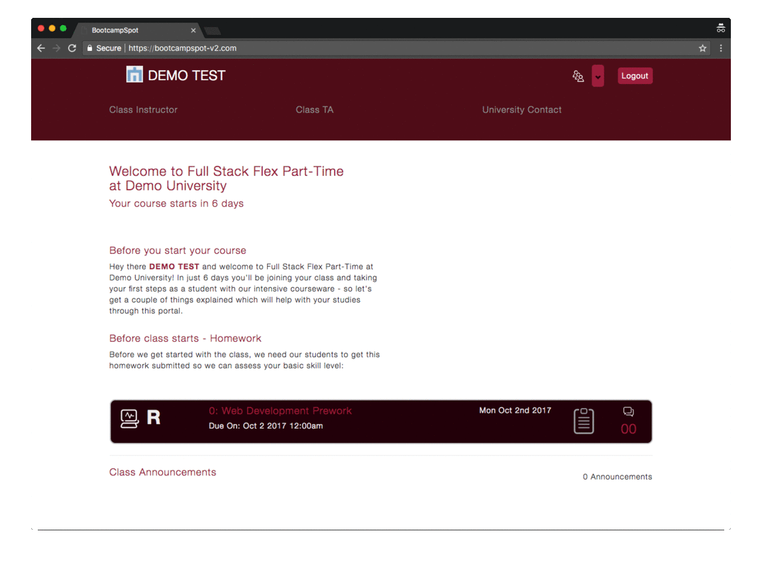
Submitting Homework

Slide 15
Slack Desktop Client

Slide 16
Slack Desktop Client
Everyone take a moment to download the Slack Desktop App if you haven’t!
https://slack.com/downloads/

Slide 17
Slack

Slide 18
Online Specific Slack Channels
#01-zoom-rooms

Slide 19
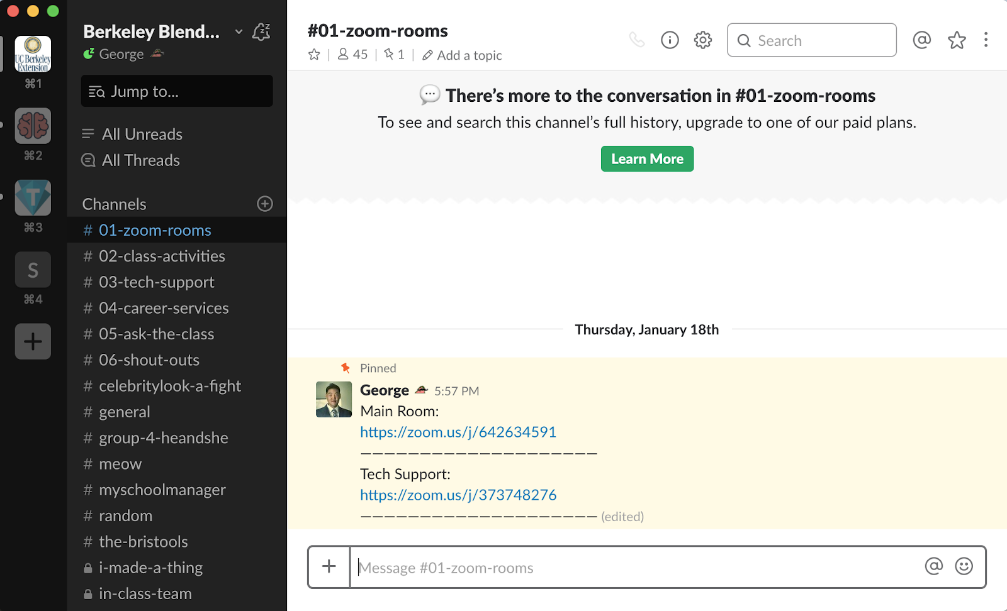
#01-zoom-rooms

Slide 20
#01-zoom-rooms
Links for Online Class:
Main Room
Tech Support Room

Slide 21
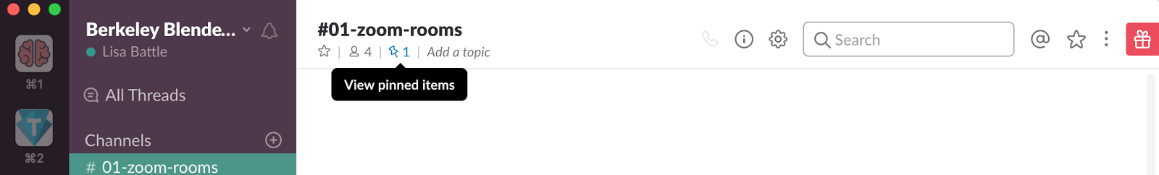
#01-zoom-rooms
The links will always be in a pinned message. Click the pin to view.

Slide 22
#02-class-activities
#02-class-activities

Slide 23
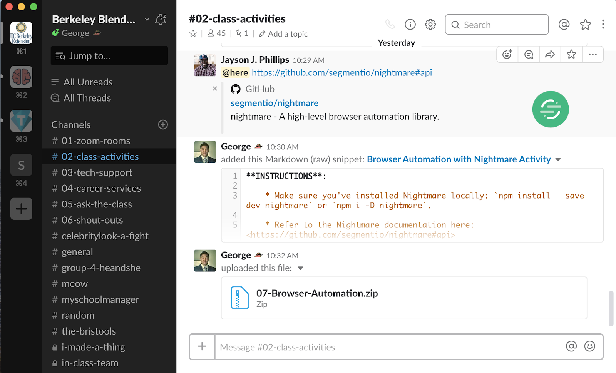
#02-class-activities

Slide 24
#02-class-activities
Activity files you’ll work on during class will be posted in #02-class-activities.

Slide 25
#03-tech-support
#03-tech-support

Slide 26
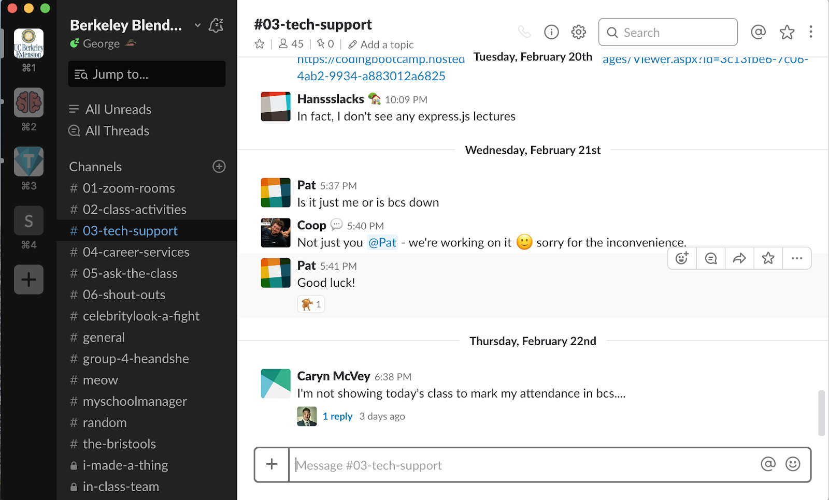
#03-tech-support

Slide 27
#03-tech-support
Technical difficulties? Post in #03-tech-support!
Your instructional staff & classmates can help.

Slide 28
#04-career-services
#04-career-services

Slide 29
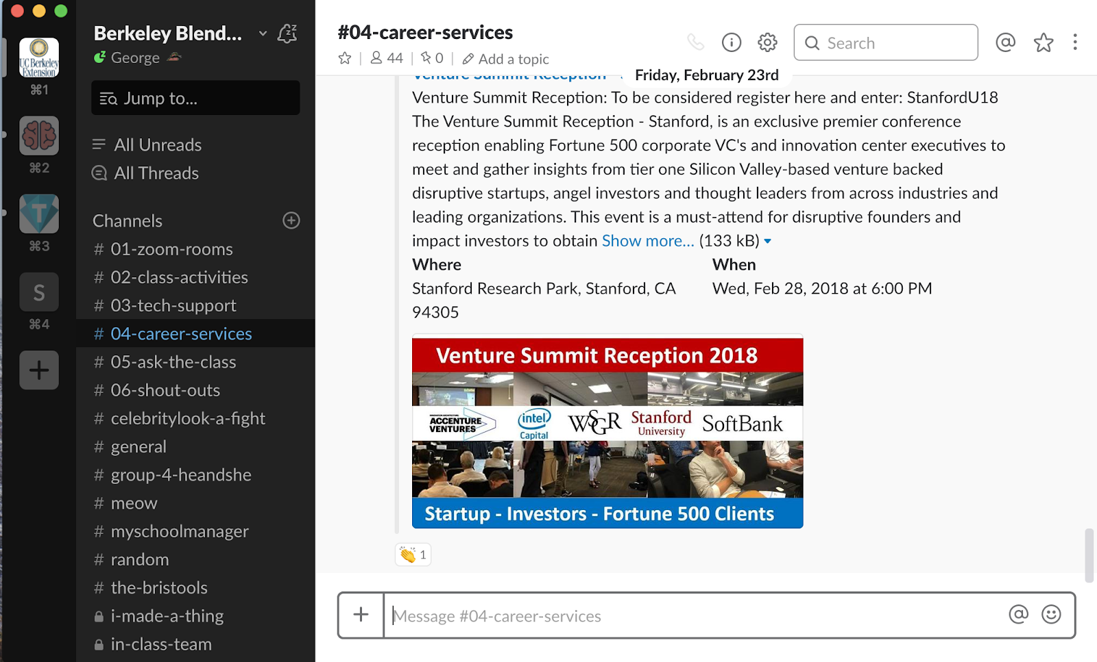
#04-career-services

Slide 30
#04-career-services
Career Questions? Post in #04-career-services
Your career director is on the case.

Slide 31
#05-ask-the-class
#05-ask-the-class

Slide 32
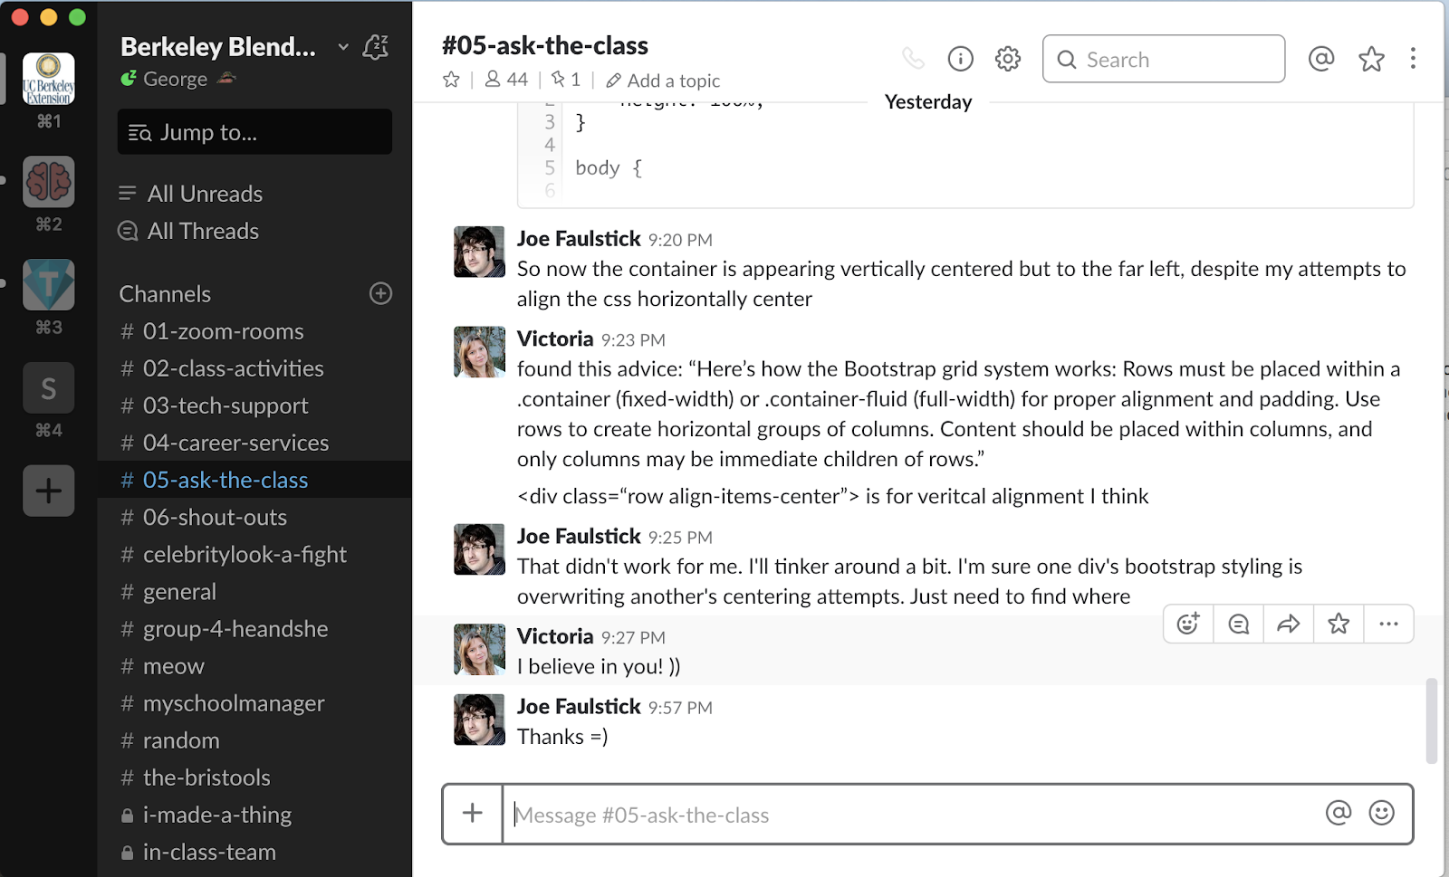
#05-ask-the-class

Slide 33
#05-ask-the-class
Post questions about activities, homework, and projects in #05-ask-the-class.
Your instructional staff & classmates can help.

Slide 34
#06-shout-outs
#05-shout-outs

Slide 35
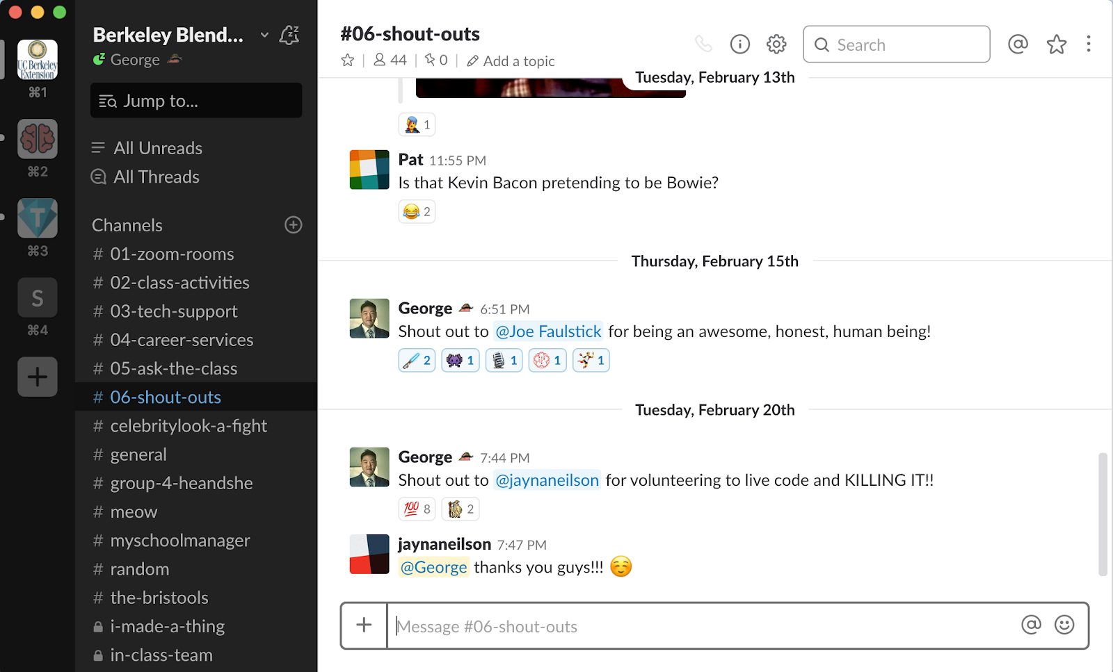
#06-shout-outs

Slide 36
#06-shout-outs
Does someone deserve a virtual high five?
Post it in #05-shout-outs so we can celebrate each other.

Slide 37
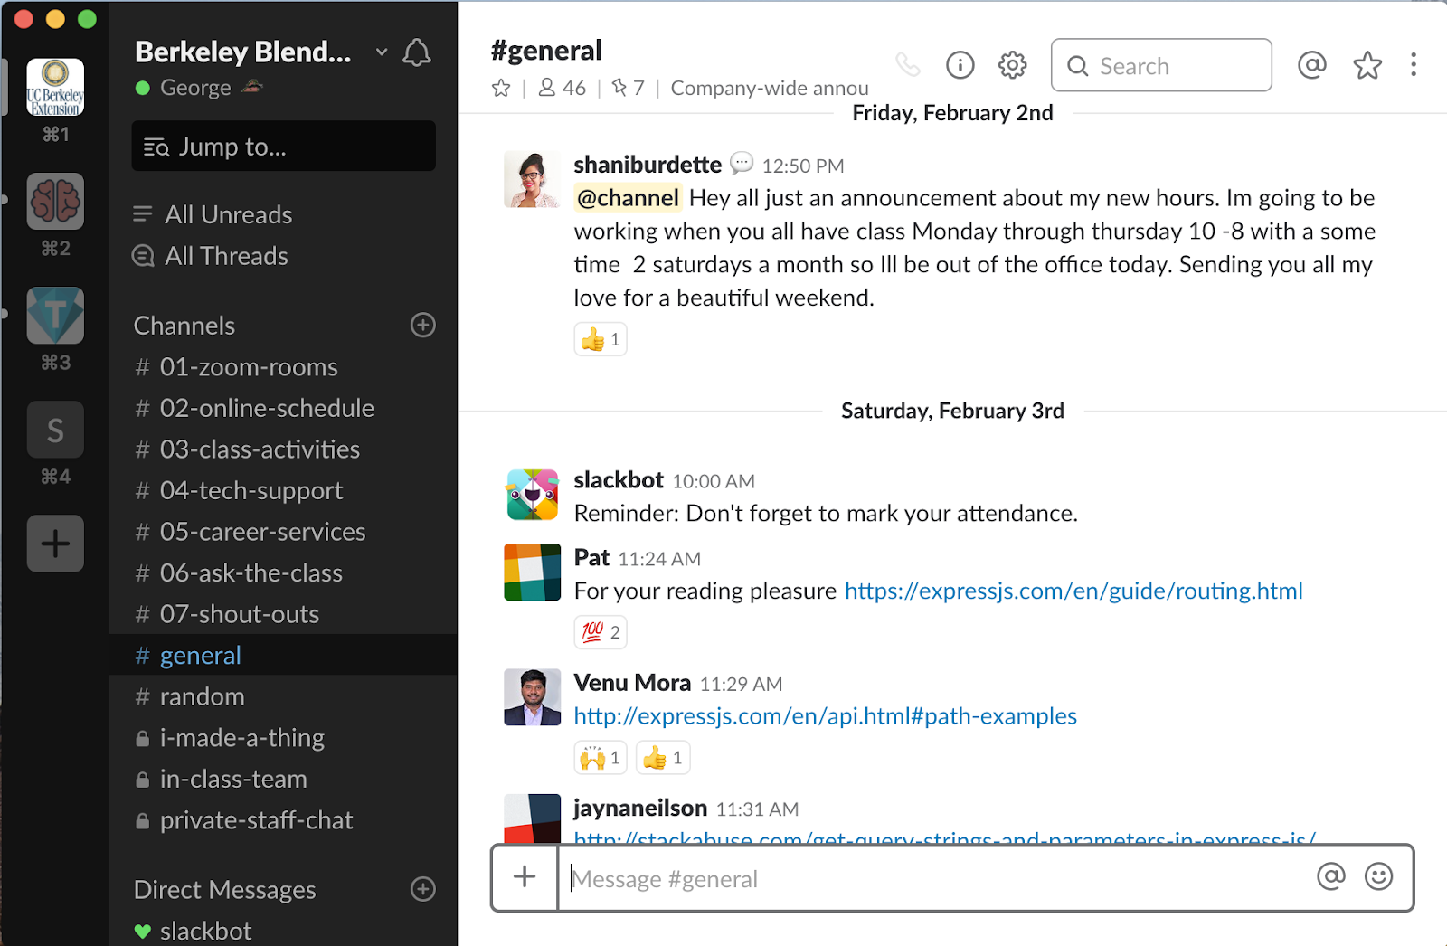
#general

Slide 38
#general
General class announcements are posted in #general.

Slide 39
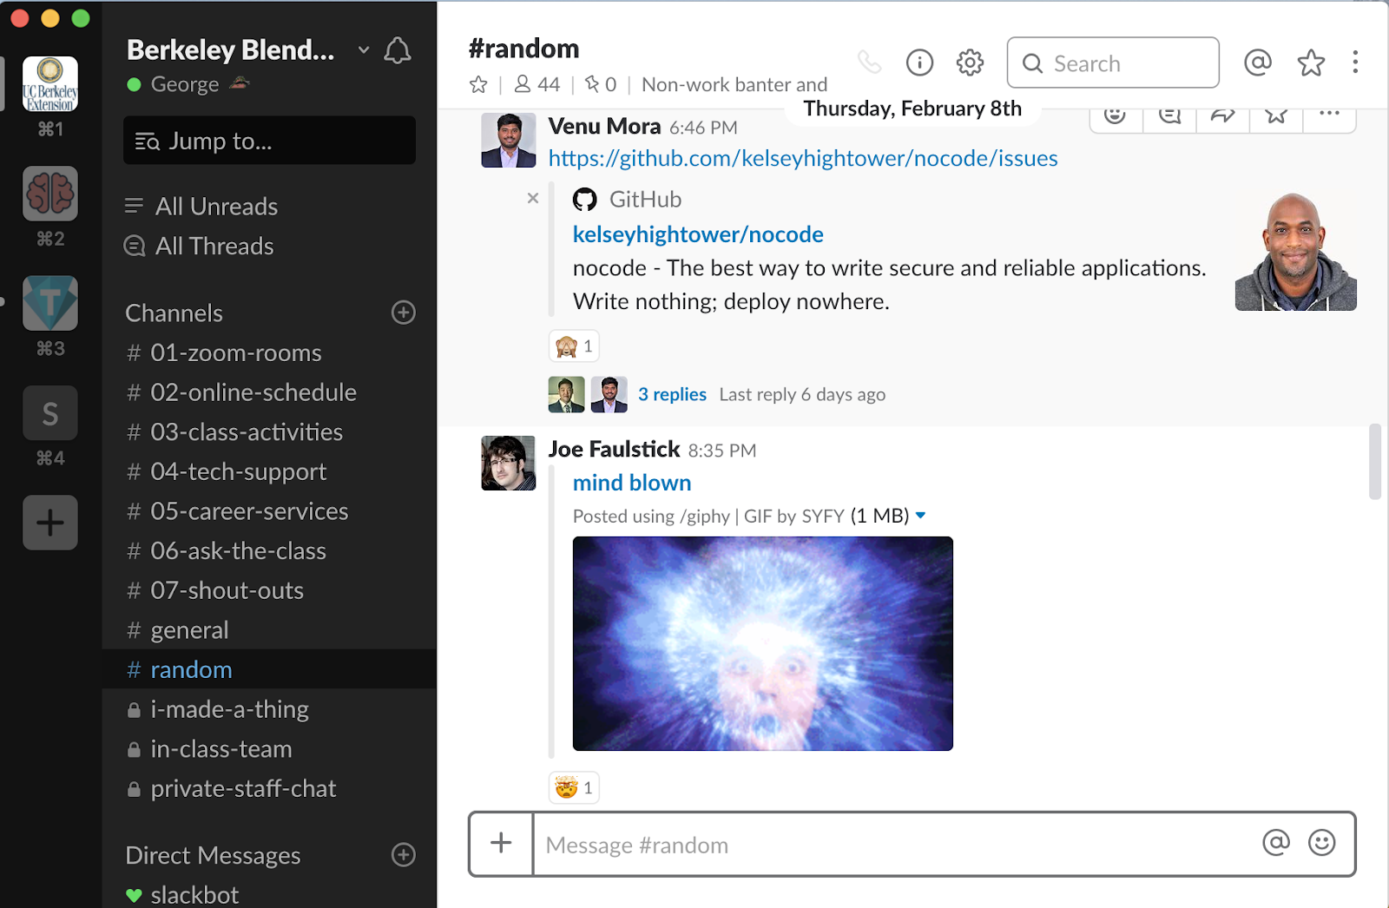
#random

Slide 40
#random
Just like it sounds...

Slide 41
Last, but not least...
Add your real name, and picture to Slack, it will help everyone start memorizing each other’s names and faces!

Slide 42
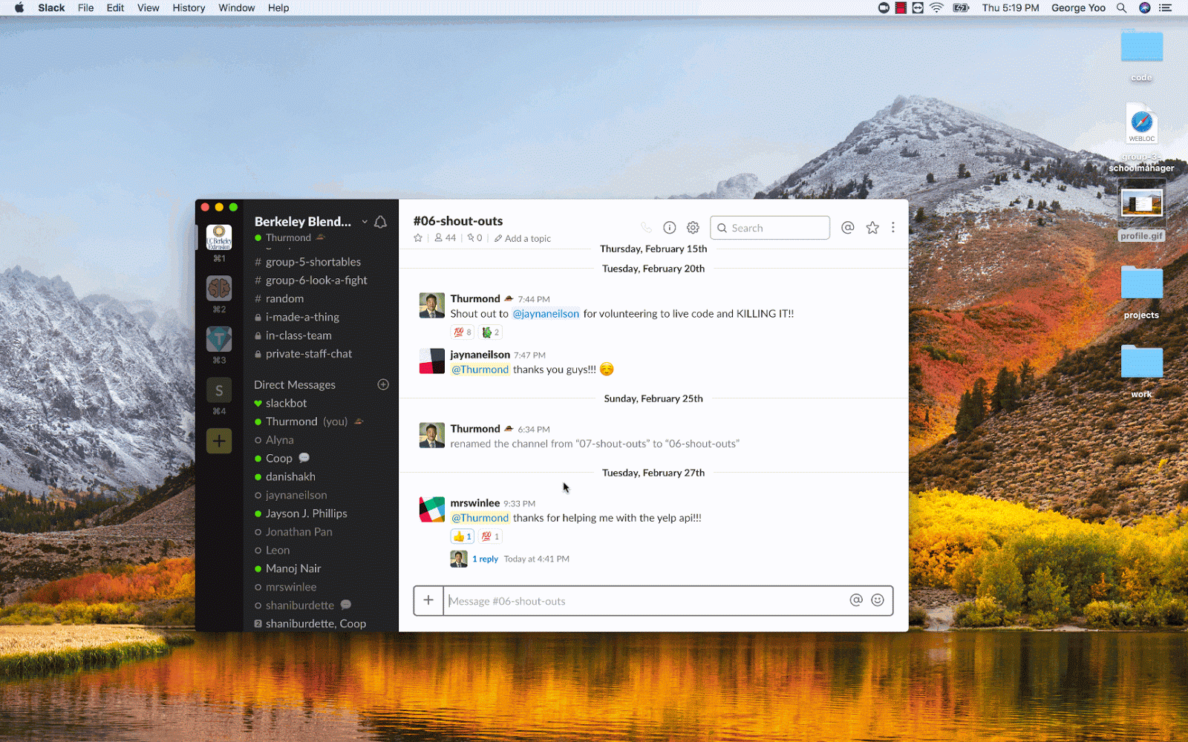
Last, but not least...

Slide 43
Required Equipment

Slide 44



Web Cam, Headphones, Microphone, Monitor

Slide 45
Zoom Setup

Slide 46
Zoom Account Creation

Slide 47
Zoom Account Creation
Go to http://www.zoom.us
Sign up for a free account!

Slide 48
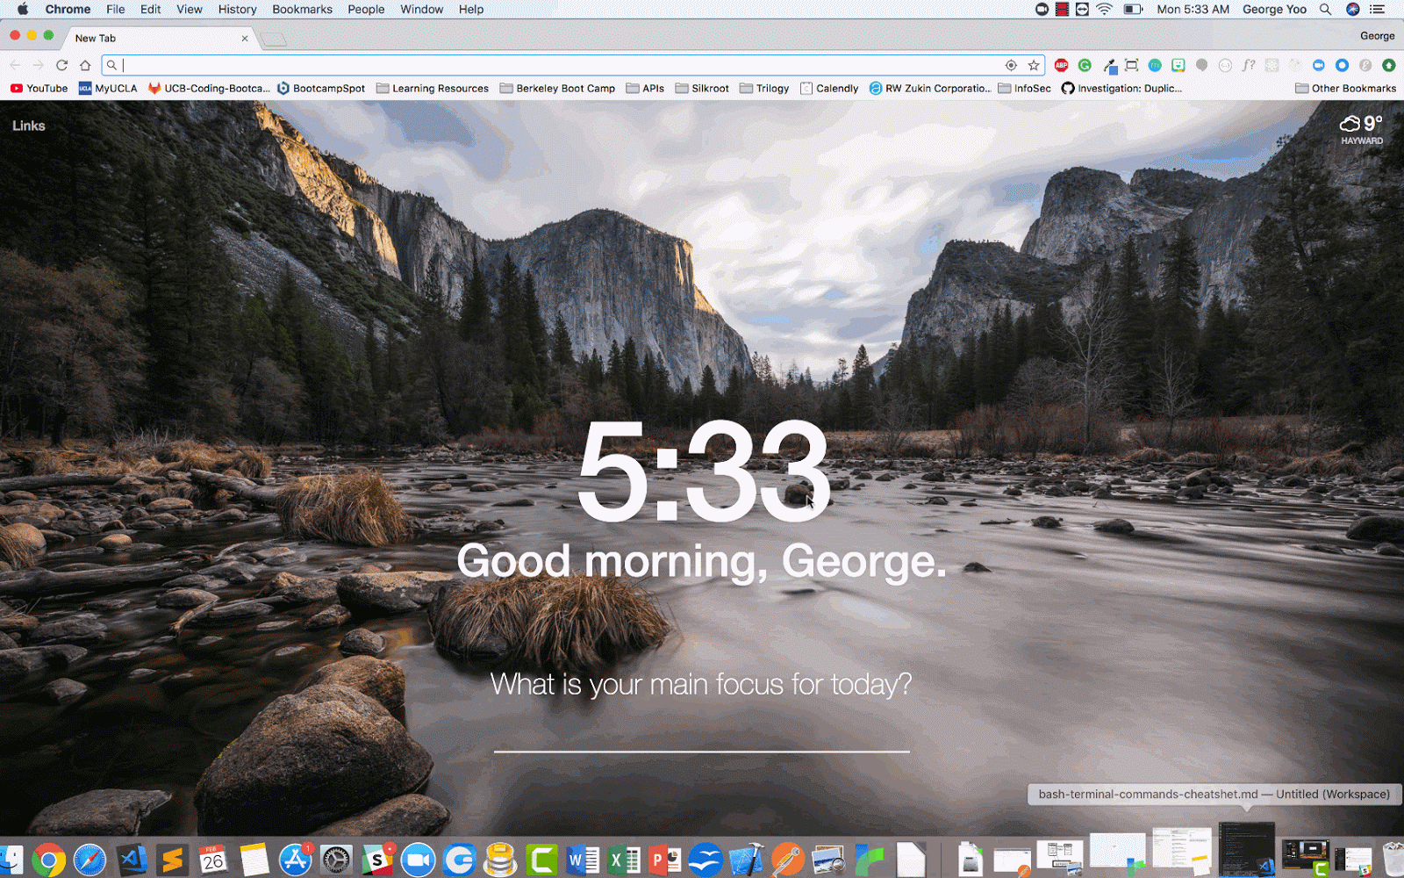
Zoom Account Creation

Slide 49
Zoom Account Creation
You can use your personal ID to meet with classmates outside of class hours (40 min max)
Notes:
(Good idea for study groups and project groups!)

Slide 50
Zoom Download

Slide 51
Zoom Download & Installation
The Zoom Client download link can be found at the bottom of the zoom.us website
OR
Click Here

Slide 52

Zoom Download & Installation

Slide 53
Hop into Zoom!
Please bookmark this link:
https://zoom.us/j/642634591
You will use this link to join office hours and main lecture every Tuesday and Thursday.
Okay! Join now, and mute yourself & your computer speakers!
Notes:
Change this slide to reflect your Class’s main zoom room URL!

Slide 54
Zoom Settings

Slide 55
Zoom Settings
Make sure you’re logged into your new zoom account!
Next, click “Zoom -> Preferences”
Notes:
“Let’s all double check our Zoom Client settings!"

Slide 56
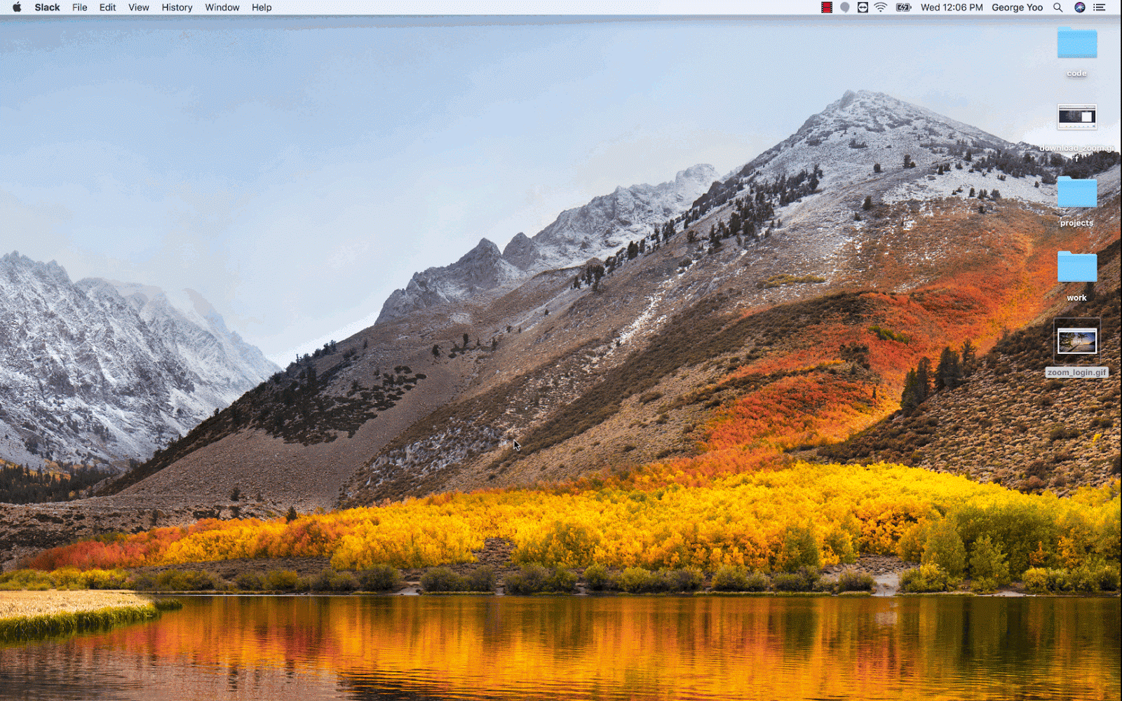
Zoom Settings
Notes:
“Let’s all double check our Zoom Client settings!"

Slide 57
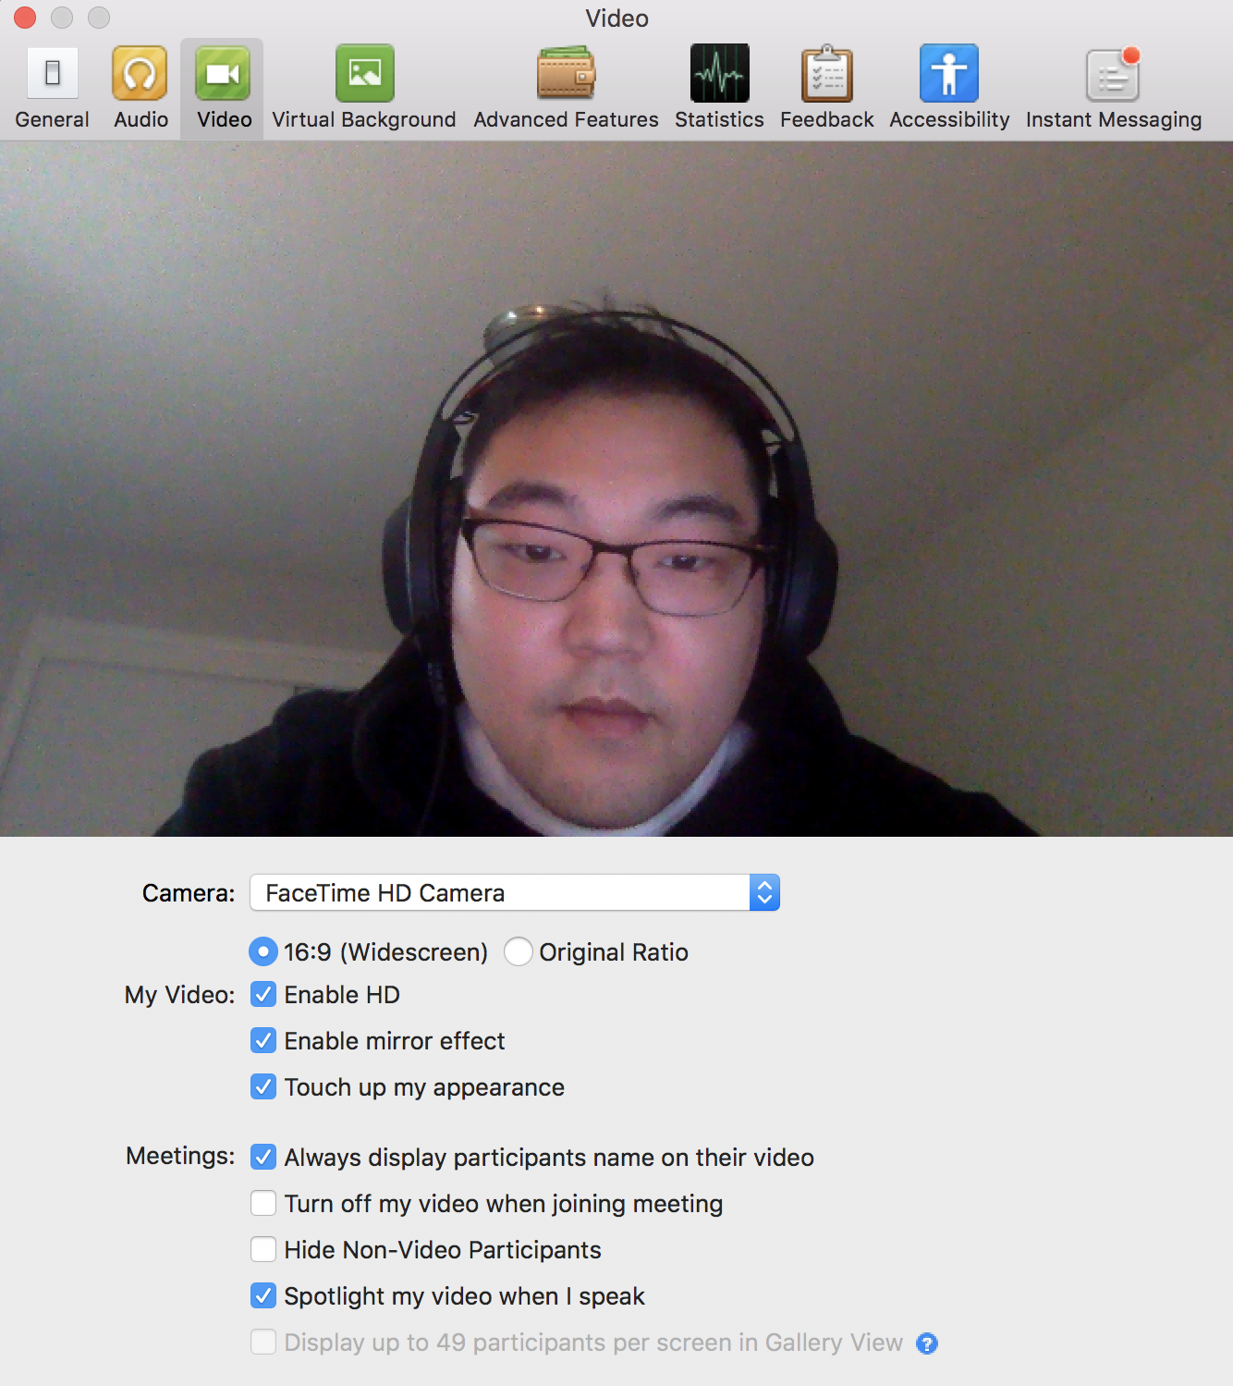
Zoom Settings
Video tab: Check "Always display participants name on their video"

Slide 58
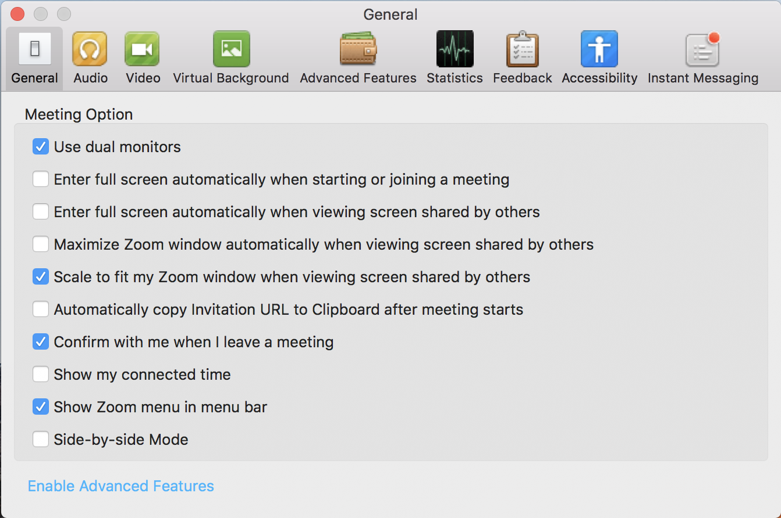
Zoom Settings
General:
- Check "Use Dual Monitors" and
- Uncheck “Full screen auto upon entering meeting”
Notes:
This is an important step as some functionality in zoom hinges on ”Use dual monitors”!

Slide 59
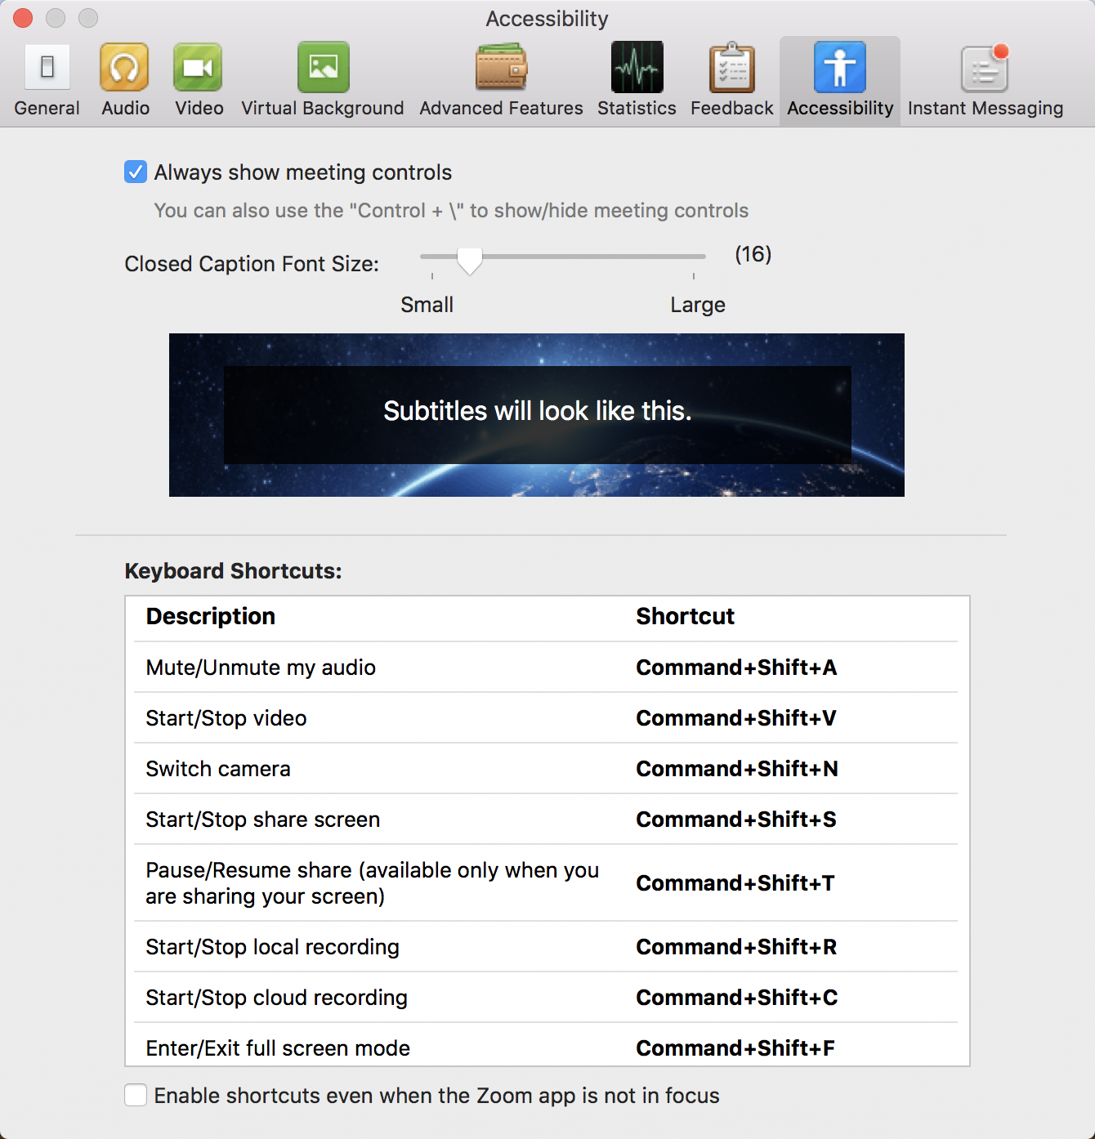
Zoom Settings
Accessibility: Check “Always show meeting controls”

Slide 60
Zoom Settings
Now that you’ve changed your settings, restart Zoom!
Remember:
You can find the Main Zoom Link in Slack!
Notes:
After everyone is done adjusting their settings, have them restart zoom so that the changes take effect.

Slide 61
Features

Slide 62
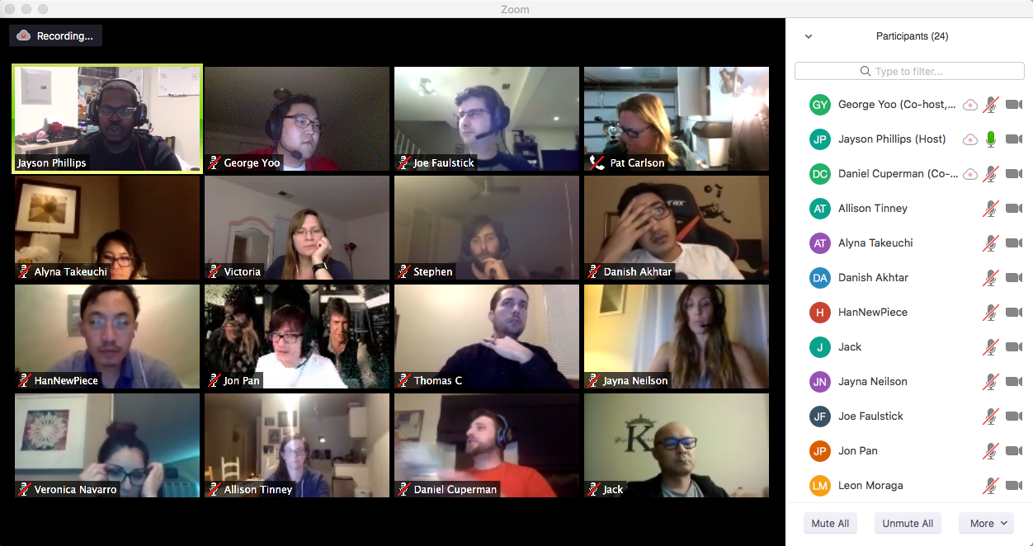
Use Gallery View to see all your classmates!

Slide 63
Features
Try it! Switch between “Speaker View” and “Gallery View” on Zoom!

Slide 64
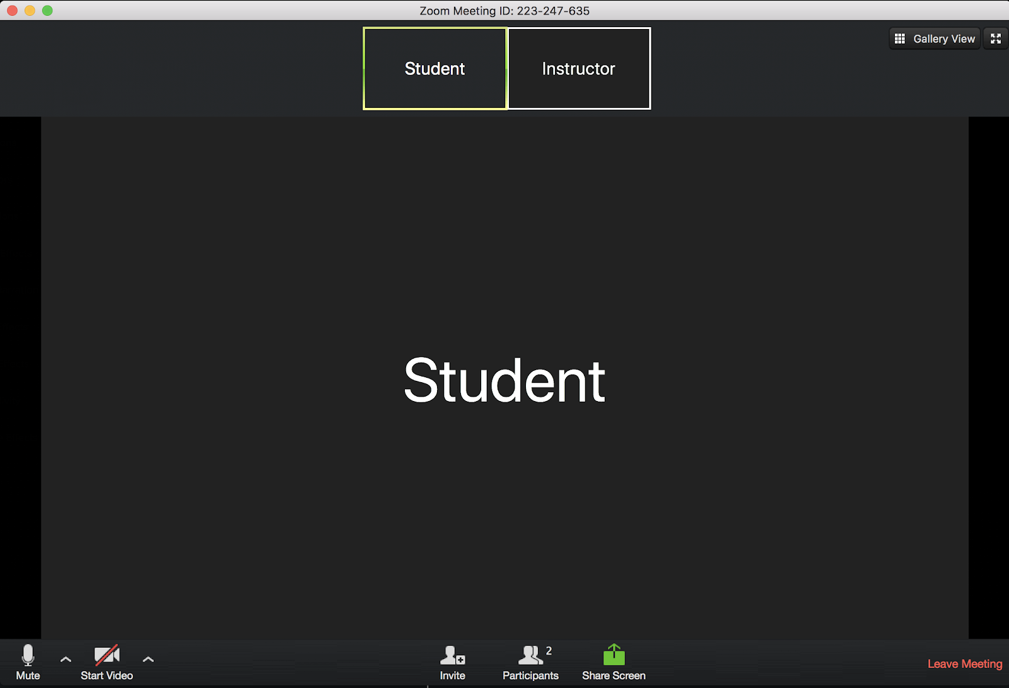
User Controls are located at the bottom of your Zoom

Slide 65
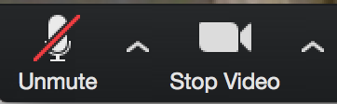
Microphone and Camera Settings
Mute yourself unless you’re speaking
Leave video on during class so the instructor can see you!

Slide 66
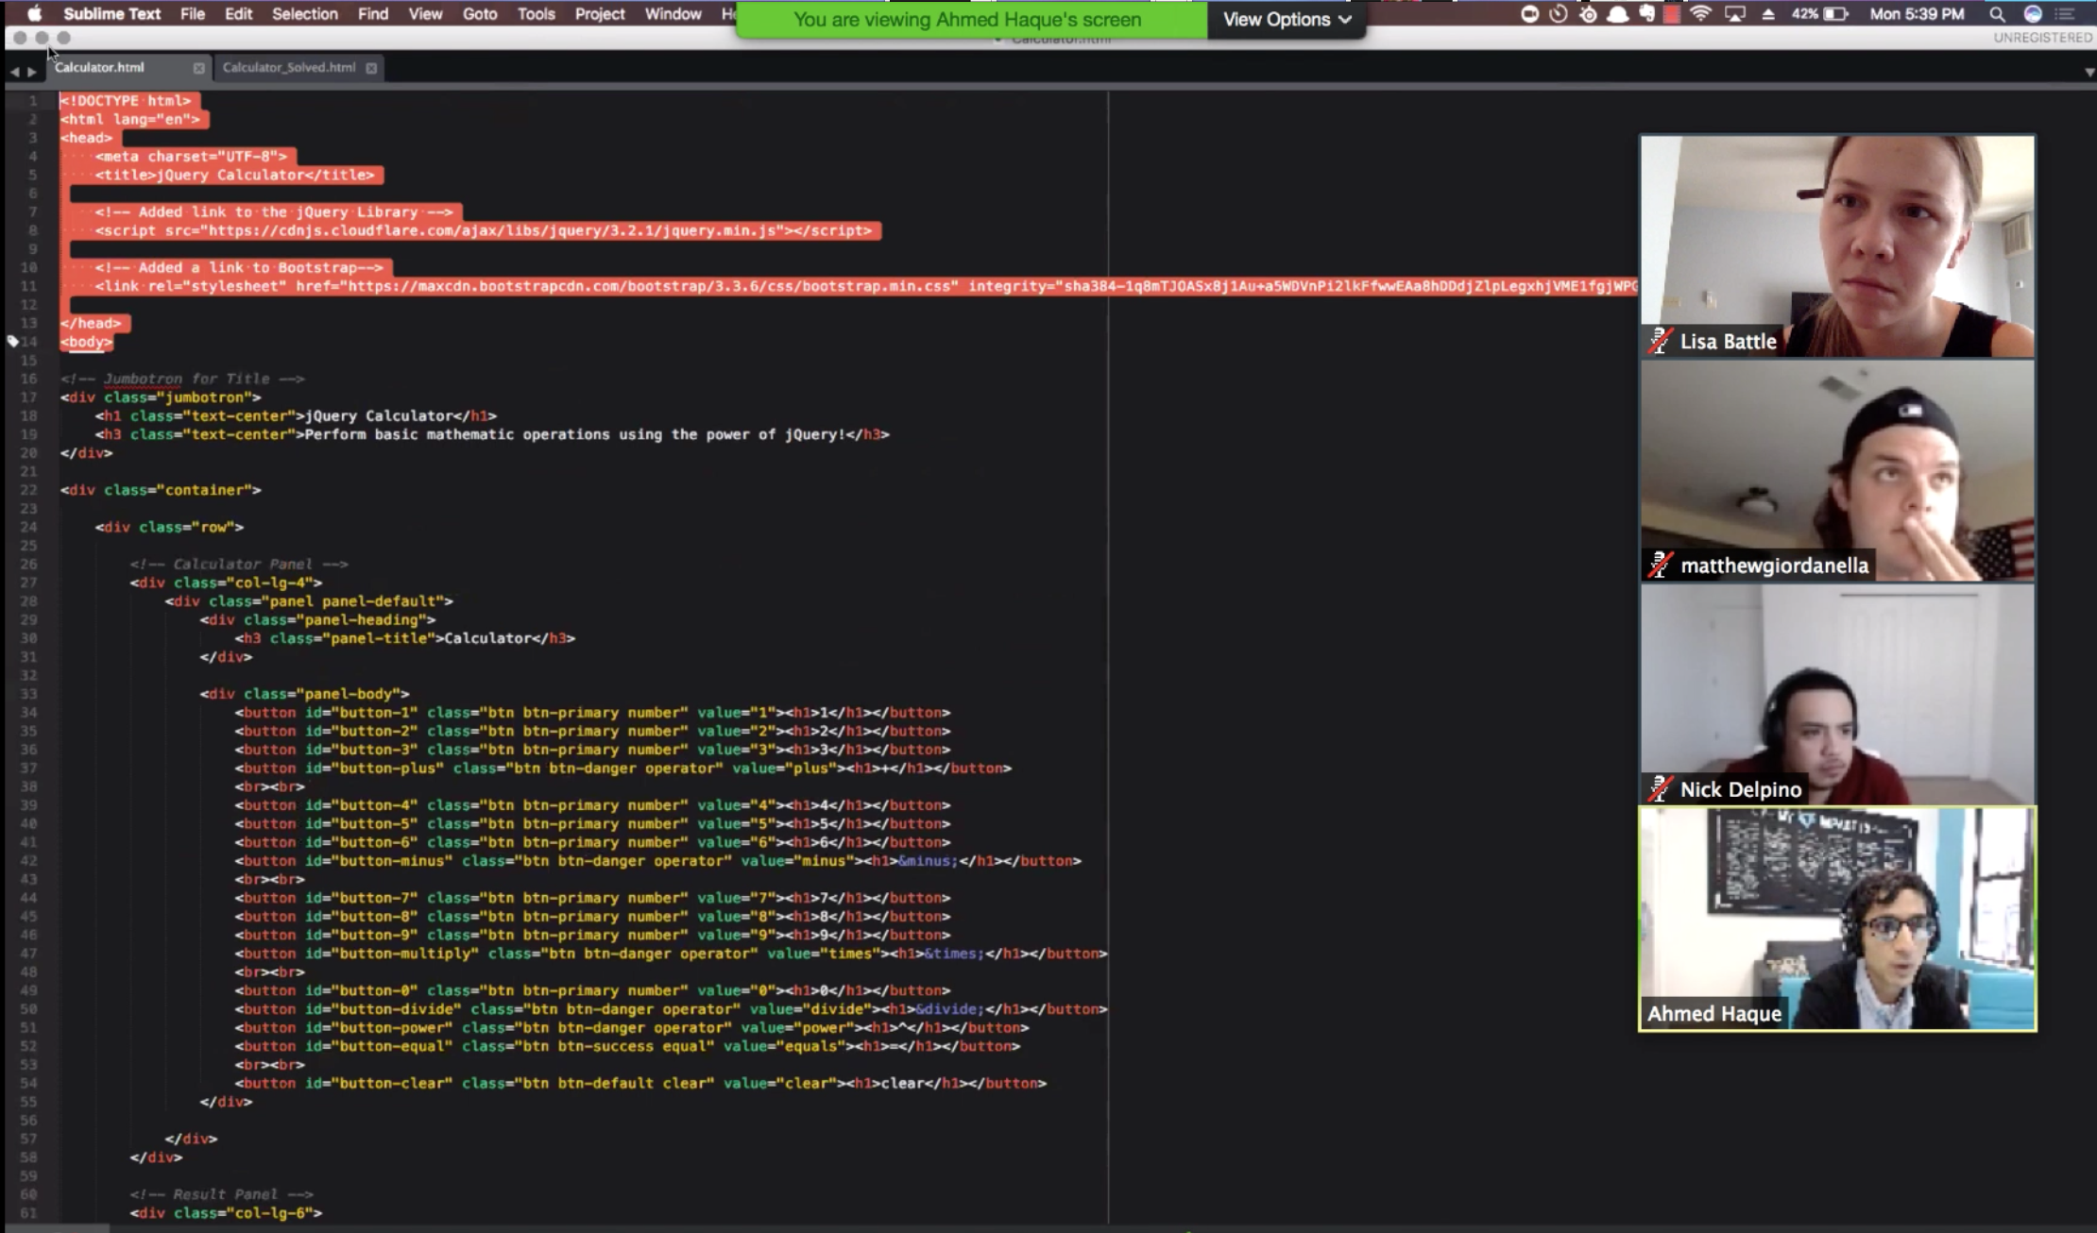
Instructor shares screen during lecture
A screen share will take over your screen.
Notes:
Un-share your screen and share it again so that the students can see what it looks like and adjust accordingly.

Slide 67
Instructor shares screen during lecture
We can make it smaller, and choose which screen to display it on!
Disclaimer: This won’t work quite right if you don’t have dual monitor’s set up.

Slide 68
Instructor shares screen during lecture
This is why you’ll need your second monitor.
You can use one screen to view what the instructor is presenting, and one screen to work on.

Slide 69
Participant Window & Raise Hand
Click “Participants” button to open menu, you’ll see a “Raise Hand” button here
You can also “Lower Hand” after raising in this menu

Slide 70
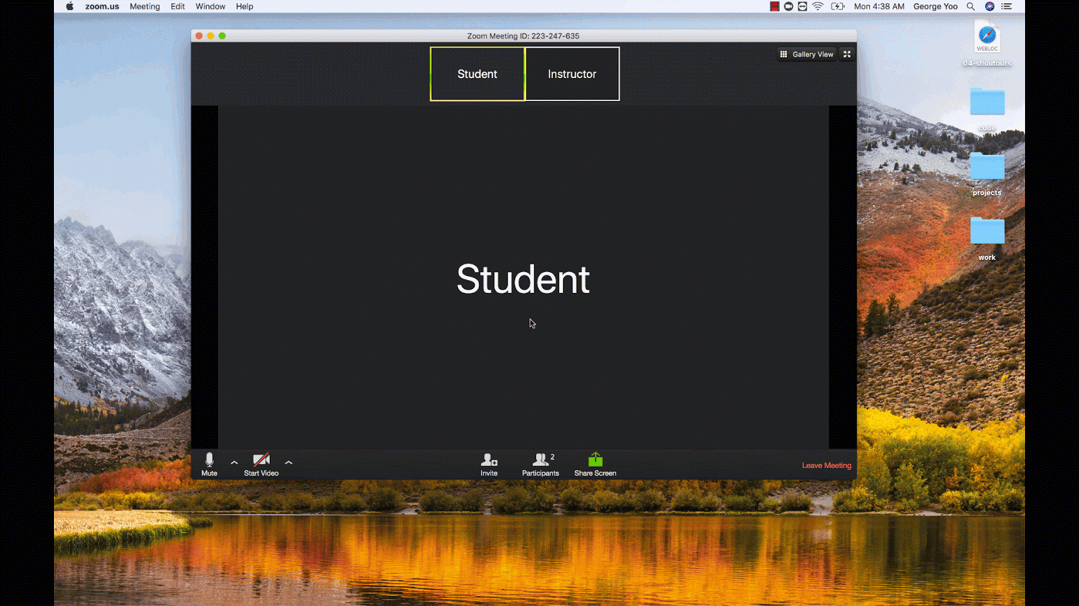
Participant Window & Raise Hand

Slide 71
Participant Window & Raise Hand
Let’s practice! Everyone raise your hand!

Slide 72
Participant Window & Raise Hand
Remember! When you are called on, unmute!
When in doubt, double check!

Slide 73
Students can share while asking/answering questions
Sharing your screen is as simple as clicking the green “Share Screen” button!
This will open a prompt to select what window you would like to share.
Notes:
(Make sure that multiple screen sharing is enabled!)

Slide 74
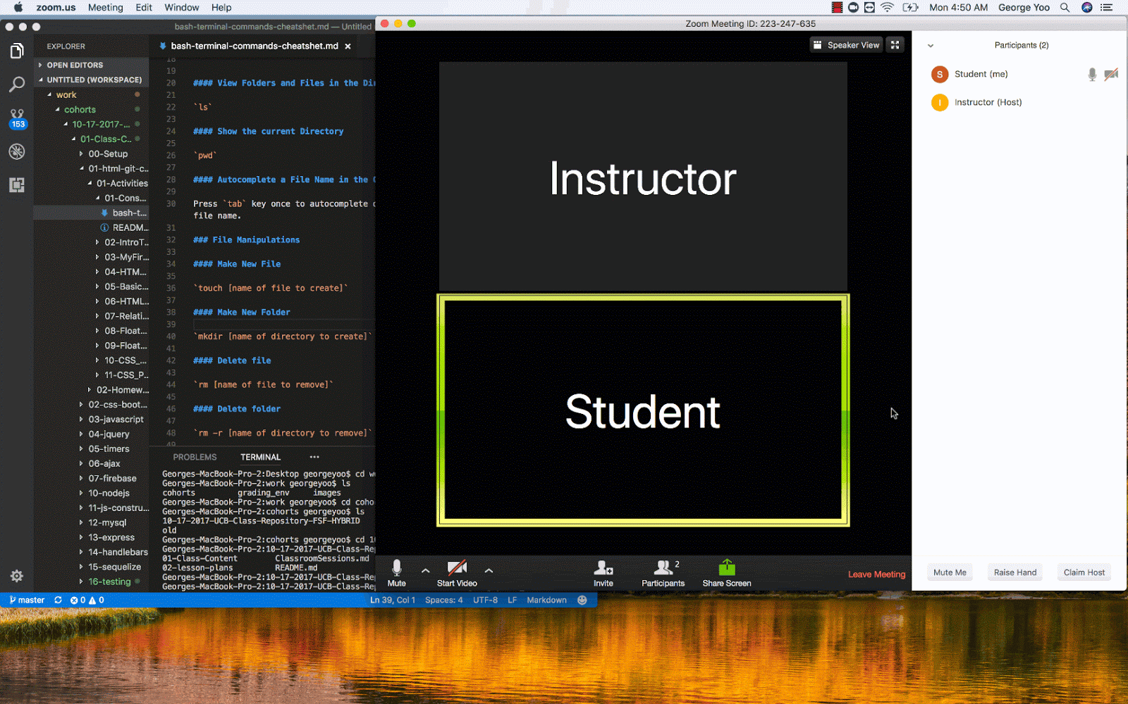
Students can share while asking / answering questions

Slide 75
Students can share while asking/answering questions
Try it! Share your screen with the class!
Notes:
Make sure that multiple screen sharing is enabled before they all start sharing!

Slide 76
Moving to group zoom room for activities
For group activities, you will receive a prompt to move into your breakout room.
Just click “Join Breakout Room” to enter!

Slide 77
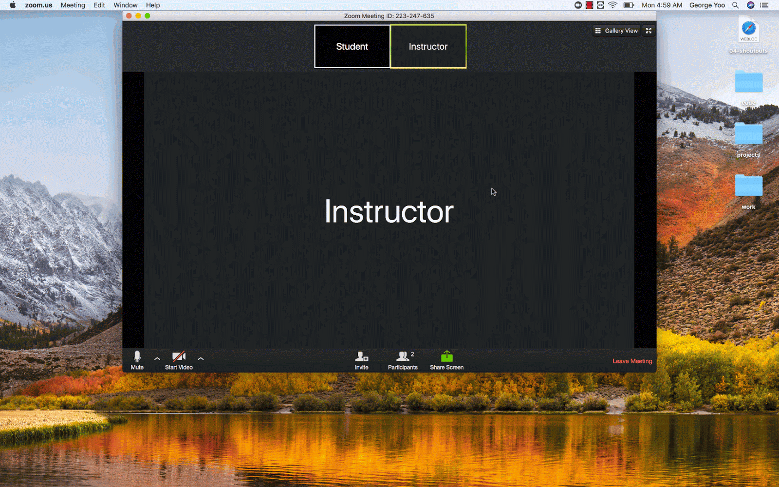
Moving to group zoom room for activities

Slide 78
Moving to group zoom room for activities
Let’s try it now!
Notes:
Create breakout rooms automatically and open breakout rooms to show students what it looks like!

Slide 79
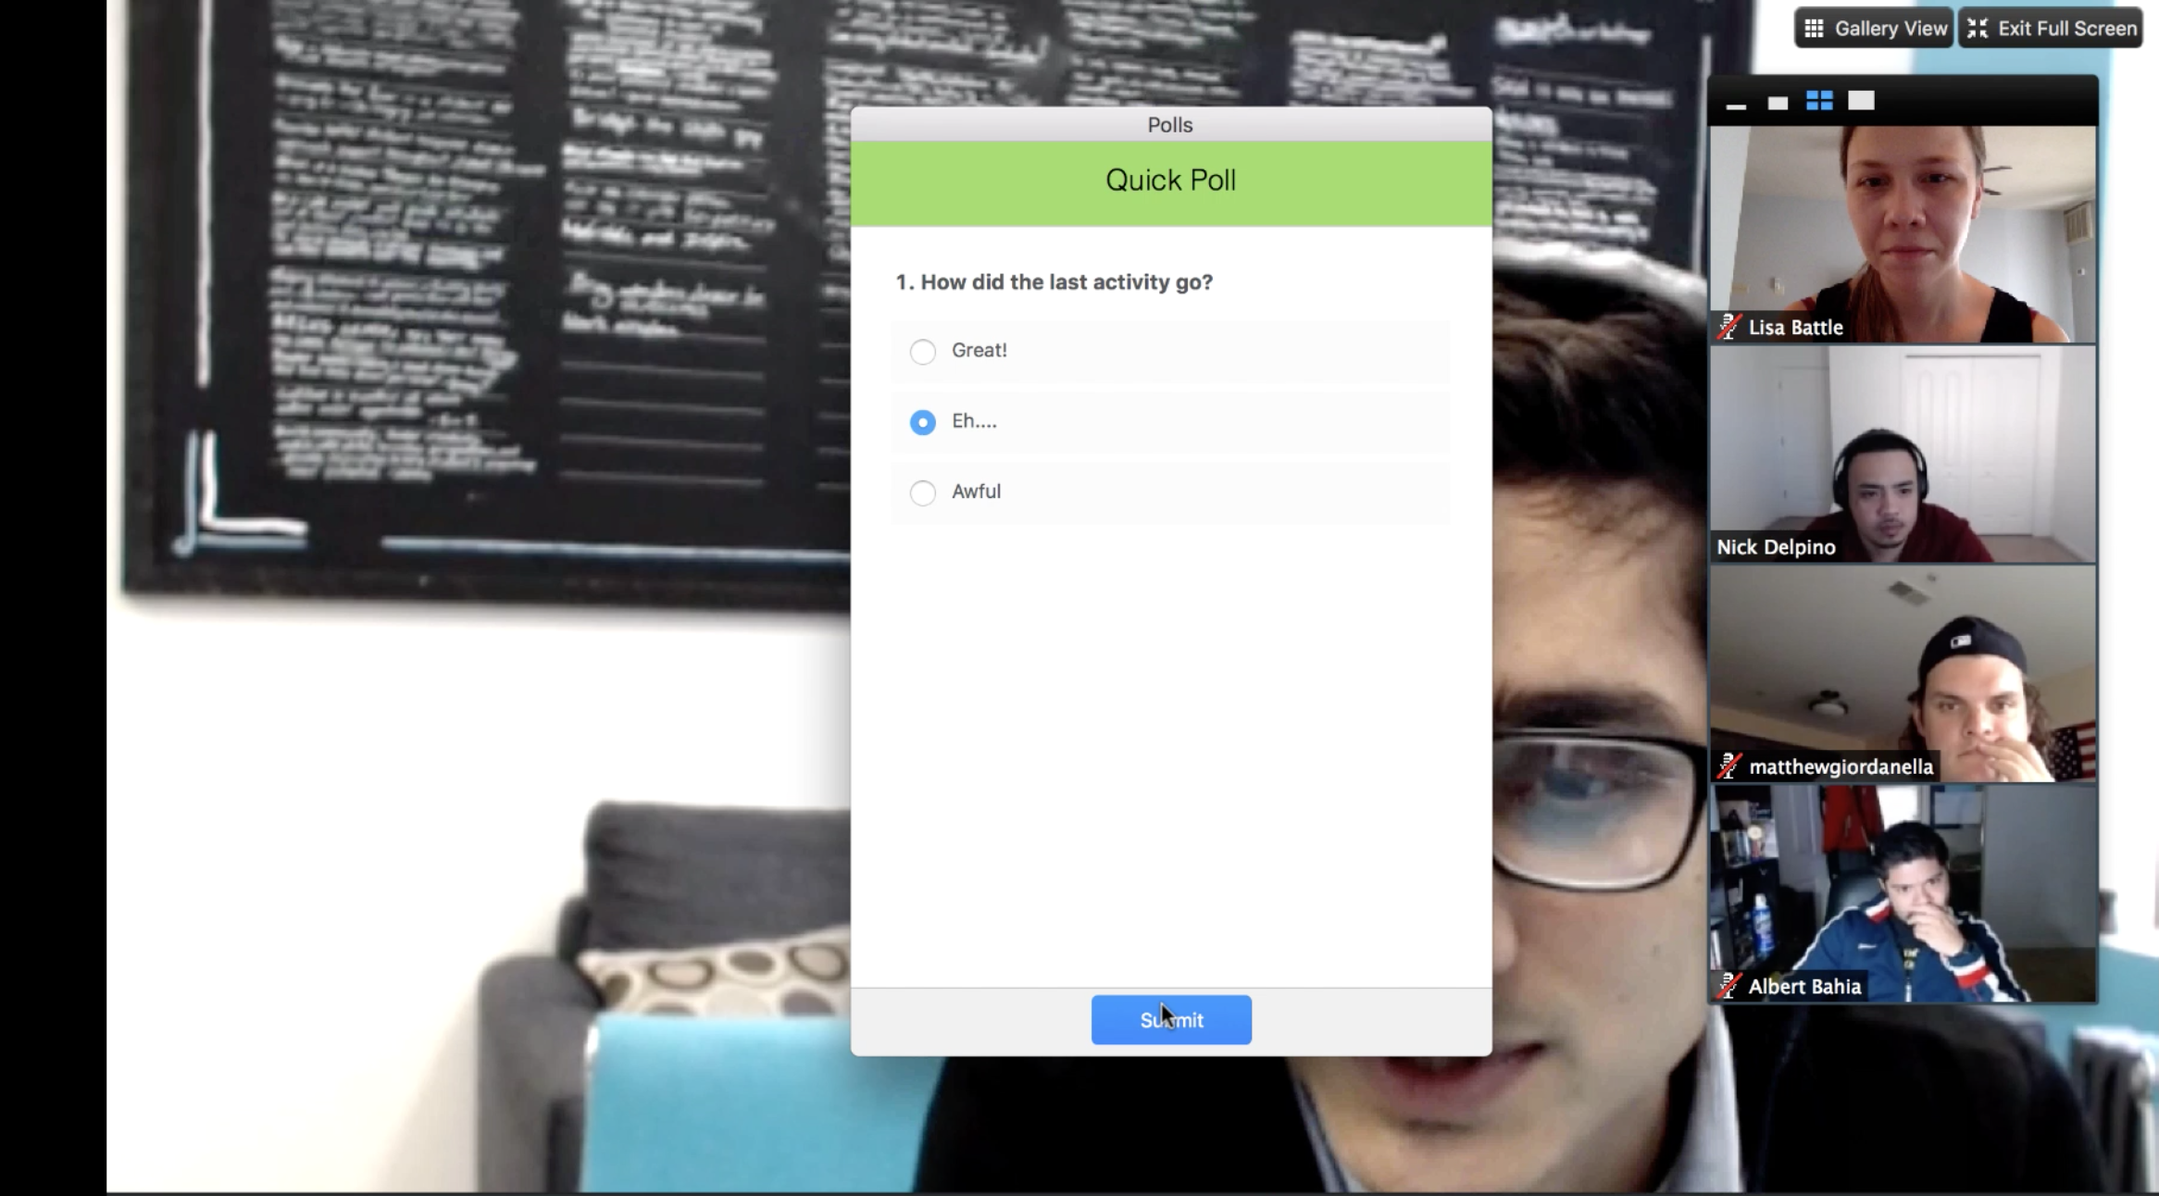
Features
Your instructor may poll you throughout the class to see how you’re feeling – don’t worry – polls are anonymous!

Slide 80
Features
Let’s practice!
Take this poll to see how we’re doing so far!

Slide 81
Visual Studio Code

Slide 82
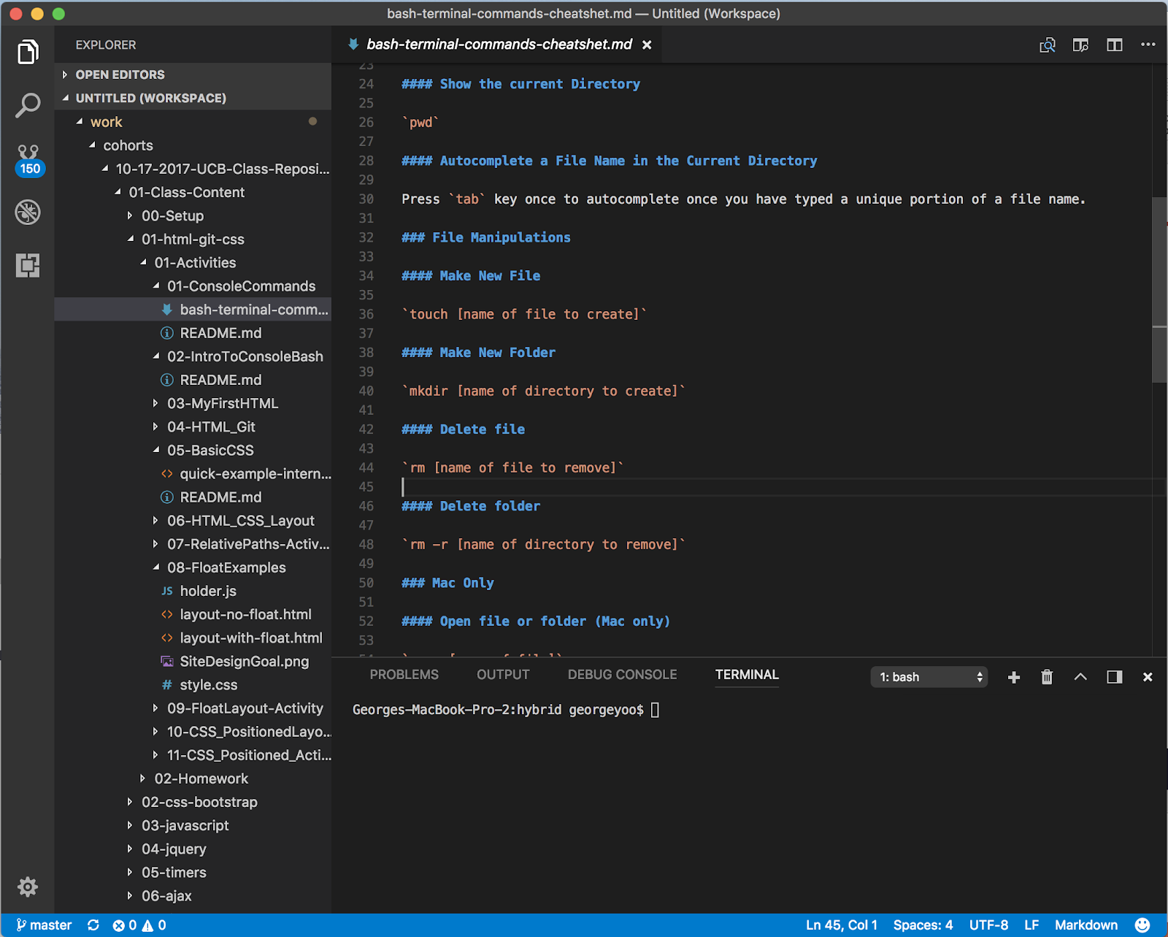
Visual Studio Code
Visual Studio Code is an editor for our code

Slide 83
VS Code Installation Check

Slide 84
Get Your Screens Right
Notes:
We’ll now be going over a suggested way to set up your screens so that you can maximize screen real estate! Keep in mind that this is just a suggestion! Do what works for you.

Slide 85
Get Your Screens Right...
Before every online class:
Open Slack
Open Zoom Main Room
Open Bootcampspot, mark attendance
Open VS Code

Slide 86
Get Your Screens Right...
Screen 1 (Projector):
Zoom
Screen 2 (Workspace):
Slack
VS Code

Slide 87
Break Time!

Slide 88
Prework

Slide 89
Software Checklist
At this point, you should have each of these installed:
Slack
Visual Studio Code
Git for Version Control
Git Bash (Windows) or Terminal (Mac)
Node.js
Heroku-CLI
Google Chrome

Slide 90
Accounts Checklist
You should also now have accounts for:
GitHub (with SSH Integration)
Heroku
LinkedIn
Stack Overflow

Slide 91
Questions

